Slide 1
Phishing Attacks: Don't Be a Victim
Learn to recognize and avoid phishing scams

Slide 2
What is Phishing?
Definition: Phishing is a cybercrime where attackers use deceptive emails, websites, or text messages to steal personal information.
Goal: To trick victims into revealing sensitive data like passwords, credit card numbers, or social security numbers.

Slide 3
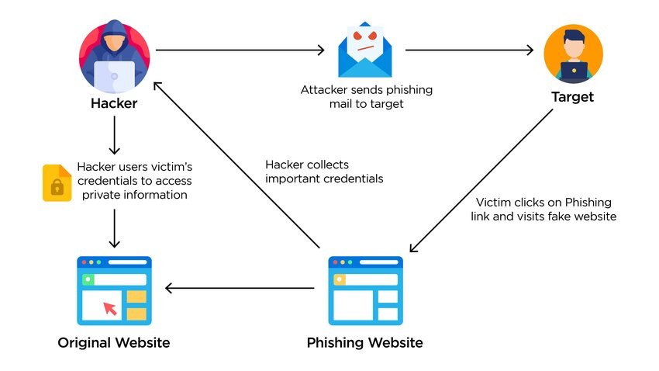
How Phishing Works
Social Engineering: Attackers use psychological manipulation to gain trust.
Impersonation: They pretend to be reputable organizations (banks, social media, etc.).
Urgency: Create a sense of urgency to pressure victims into acting quickly.

Slide 4
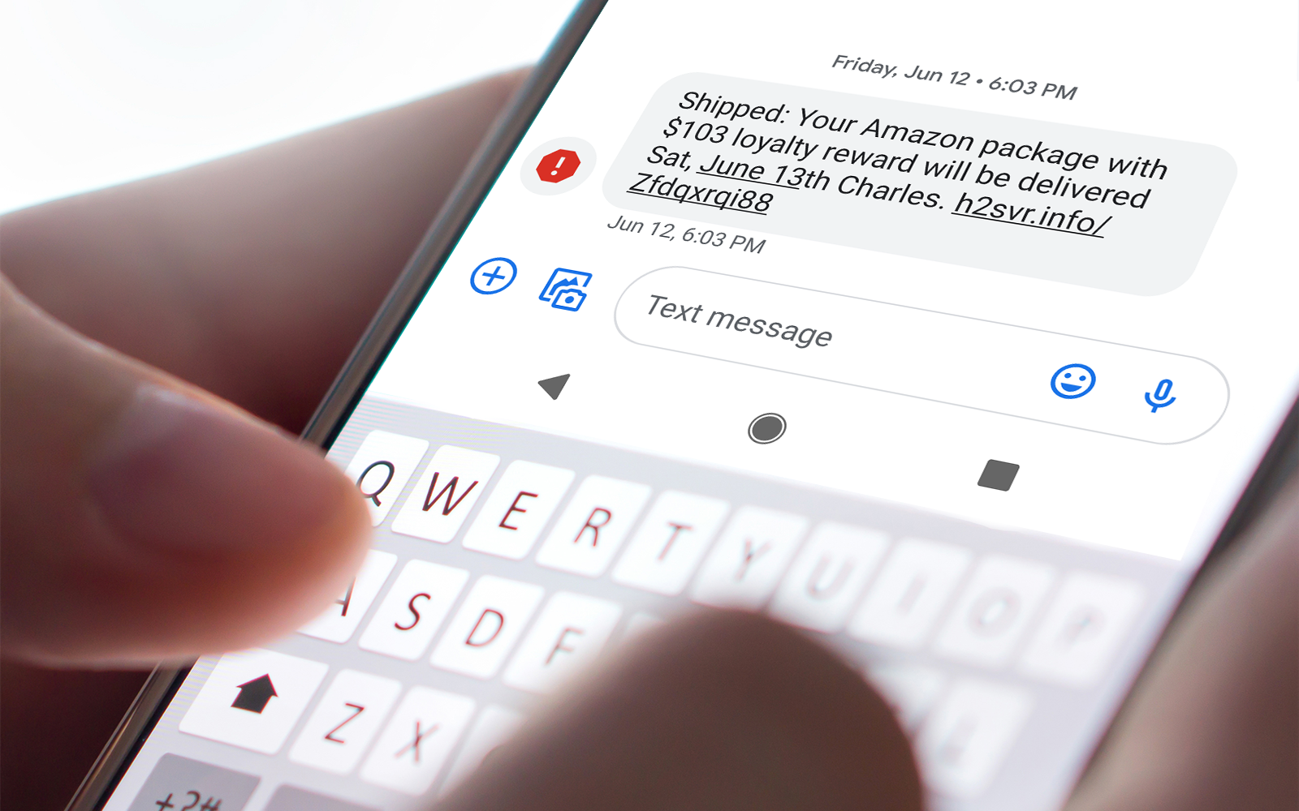
Common Phishing Tactics
Email Phishing: Deceitful emails with malicious links or attachments.
Smishing: Phishing via SMS text messages.
Vishing: Phishing through voice calls.

Slide 5
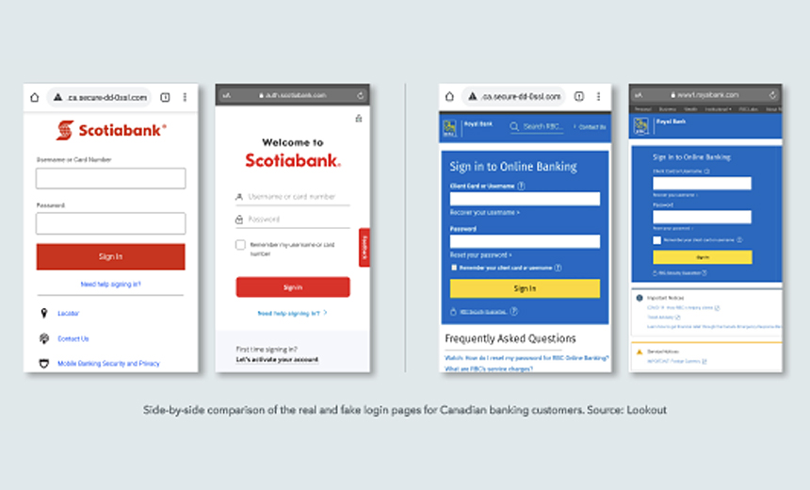
Recognizing Phishing Emails
Suspicious Sender: Check the email address for typos or unusual domains.
Generic Greetings: Avoid emails with generic greetings like "Dear Customer.“
Urgent Actions: Be wary of emails demanding immediate action.
Request for Personal Information: Legitimate companies won't ask for sensitive data via email.

Slide 6
Phishing Websites
URL Verification: Hover over links to check the actual URL.
Look for HTTPS: Ensure the website is secure with HTTPS.
Check for Spelling Errors: Phishing websites often have typos.

Slide 7
Social Engineering Tactics
Impersonation: Be cautious of unsolicited requests for personal information.
Baiting: Avoid clicking on enticing links or attachments without verification.
Tailgating: Protect your computer when in public places.

Slide 8
Protecting Yourself
Strong Passwords: Create complex and unique passwords.
Beware of Public Wi-Fi: Avoid accessing sensitive information on public networks.
Keep Software Updated: Install security updates promptly.
Backup Data: Regularly back up important files.

Slide 9
What to Do If You've Been Phished
Change Passwords Immediately: Update passwords for compromised accounts.
Monitor Bank Accounts: Check for unauthorized transactions.
Report the Phishing Attempt: Contact your email provider and relevant authorities.

Slide 10
Conclusion
We Should be cautious of suspicious emails, websites, and requests. We Should Educate others as well by sharing phishing prevention tips with friends and family.

